Slide 1
THE ROLE OF HEADTEACHERS AS PEDAGOGICAL LEADERS IN THE CONTEXT OF THE NEW NORMAL A presentation on teacher readiness for school re-opening by Daisy Aliwaru Principal, National Teachers’ College, Muni; Harriet Senkaali Principal Education Officer, Dept. of Private Schools & Institutions, MoES; & Patrick Ginyakol Okello Principal, St John Bosco Nyondo PTC, Mbale 2021

Slide 2
Presentation Outline
Understanding leadership
Core functions of School Leadership
Pedagogical leadership( Aspects & Skills)
Key Pedagogical roles of the head teacher in the new normal
Understanding safe & gender responsive learning environment
The Traits of Successful School Leaders

Slide 3
Understanding leadership
Leadership is the process of influencing people so that they will strive willingly towards the achievement of group goals - Koontz and O’Donnell (2005)
The more leaders focus their influence, their learning and their relationship to the teachers on the core business of teaching/learning, the greater their influence on students’ outcomes (Robinson - Hohepa & Lloud(2009)

Slide 4
Key Leadership Skills and Practices
Key Leadership Skills and Practices
Self development
Team development
Ethical practices and civic-mindedness
Innovation
Strategic thinking and acting

Slide 5


Slide 6
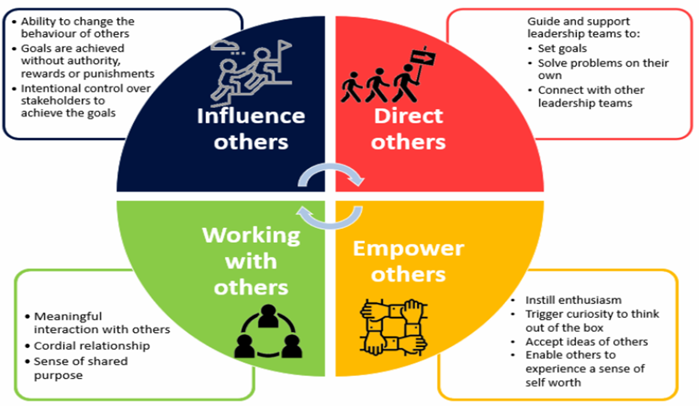
Core functions of School Leadership
Mythili, 2021)

Slide 7
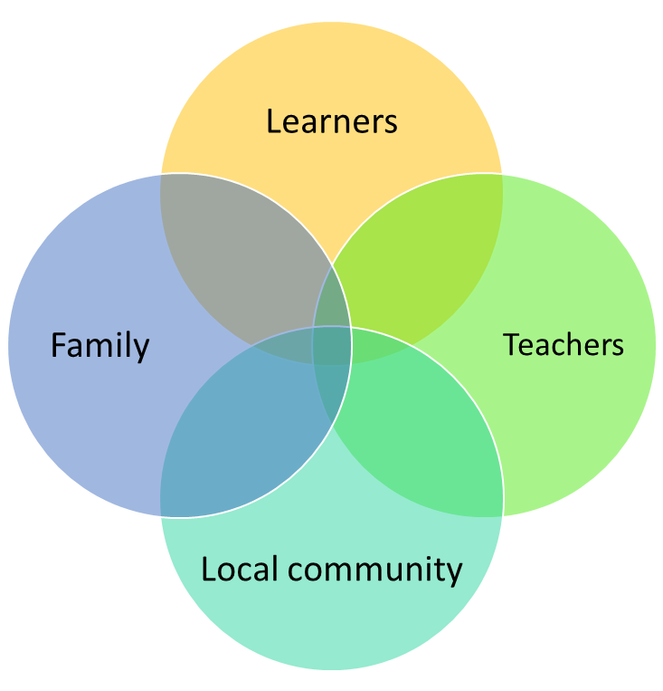

Pedagogy
Malcolm Knowles (1980) highlighted that pedagogy is“the art and science of teaching children”.
Pedagogy is based on the study of the learning process in children and includes methodologies and strategies that are being used to impart education to kids (Aven, Terje, and Ortwin Renn, 2010).

Slide 8
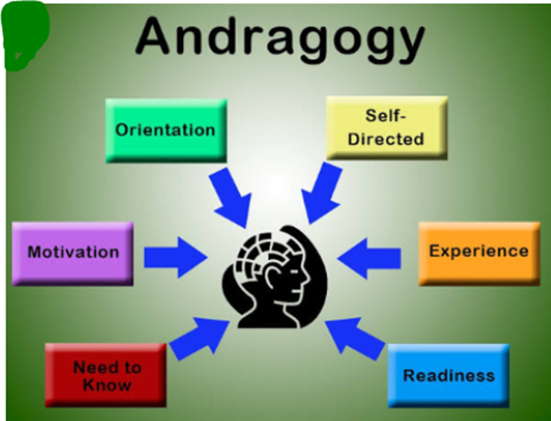
Andragogy
Malcolm Knowles (1980) furthermore argued that andragogy as “the art and science of helping adults learn”.
These are strategies that focus on adults and are concerned with making them learn more effectively and efficiently (Aven, Terje, and Ortwin Renn, 2010).

Slide 9
Pedagogical leadership
Pedagogical leadership has a stronger focus on leader involvement in teaching and learning” (Robinson, Hohepa & Lloyd, 2009).
Pedagogical leadership is about supporting & improving teaching & learning.

Slide 10
Pedagogical leadership (cont’d)…
Head teachers’ pedagogical leadership involves;
setting and monitoring teaching goals,
providing appropriate resources,
supervising the teaching programme and,
observing and providing feedback to teachers,
Integrating patriotic values in all activities of the institution;
ensuring a high-quality teaching and learning.

Slide 11
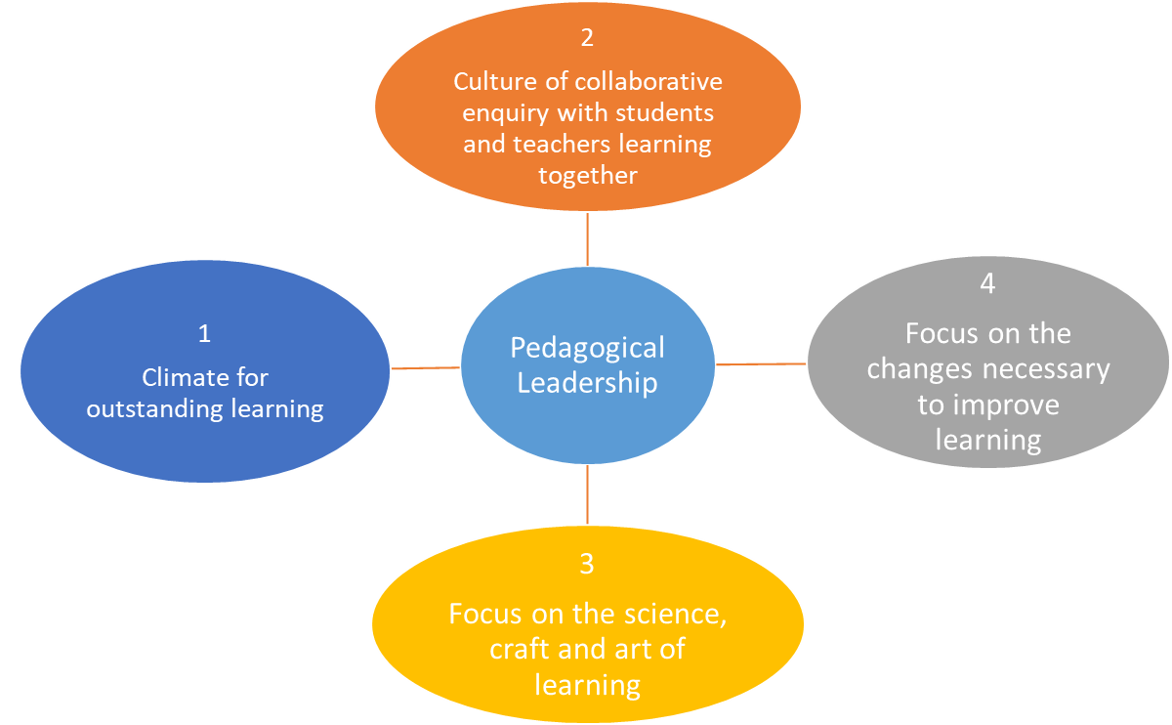
Aspects of pedagogical leadership

Slide 12
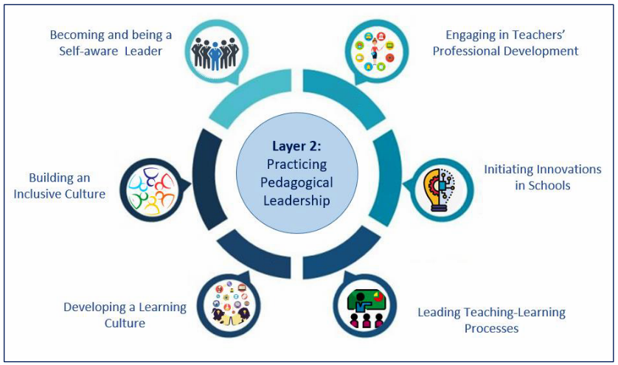
Pedagogical leadership skills for ensuring student learning
Pedagogical
Leader
(Mythili, 2021)

Slide 13
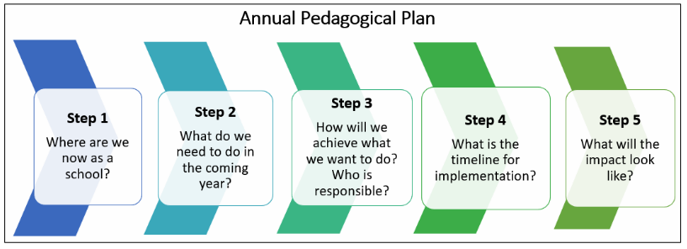
Pedagogical Plan for Leading Learning
The pedagogical plan is strategically built on the identified needs & gaps of the school.
It is a process-based planning exercise aimed at improving students learning.
Layer 2 of the Pedagogical Leadership Framework is the back bone for developing the plan.
(Mythili, 2021)

Slide 14
Key Pedagogical roles of the head teacher in the new normal
Creating a safe and gender responsive learning environment
Mentoring and coaching others
Ensuring that there is a Plan and budget.
Management of school resources: e.g. human resource, financial resource, students and teacher activities
Decision making: in a closer collaboration with different stakeholders.
At the realm of ensuring the implementation of Covid-19 SOPs

Slide 15
Key Pedagogical roles of the head teacher in the new normal (Cont’d…)
Provision of relevant information to all the stakeholders
Provide guidance and counselling to parents, student & community
Upholding patriotism and integrating it in all activities of the institution, to ensure a high-quality teaching and learning
Establishing new school cultures: in consideration of new normal in order to institute the new system in schools and sustain it
Providing regular supervision

Slide 16
Understanding safe & gender responsive learning environment
A safe learning environment/ Child friendly school is essentially one that is rights based, gender sensitive and responsive to the needs of men and women/girls and boys

Slide 17
Characteristics of a safe and gender responsive learning environment
Reflects and understands the rights of every child-
Gender and disability sensitive and responsive
(takes into consideration the unique needs of all learners)
Provides education based on reality
Ensures respect and equality of opportunities for all
Provides education that is affordable and accessible
Adopts gender responsive pedagogy
Adopts positive disciplining

Slide 18
Components of a gender responsive learning environment
Gender responsive Policy environment
Physical environment
Psychological/individual attributes
Teachers’ development/skills
Parental engagement.

Slide 19
Gender responsive Policy environment
National level
School based policy Checklist
The Constitution of Uganda (1995
The Children (Amendment) Act (2016
The Education Act 13 (2008)
The National Child Policy (2020
Gender in Education Policy
Guidelines for the Prevention and management of teenage pregnancy
Guidelines on elimination of violence against children in schools
Vision 2040
National Development Plan III
The National Teacher Policy
MoH and MoES Guidelines on COVID -19
Are the school based policies in line with the international and National laws and policies?
Are the school rules and regulations in line with the International and National policies?
What is the school policy on pregnancies? Is it in line with the National Guidelines?
What is the school policy on management of discipline in the new normal?

Slide 20
How to make the school a gender responsive place for learning
Teacher
Learner
Review school based policies to align with the International and national laws and policies for prevention of the spread of covid-19 pandemic
Integrate the children’s rights & responsibilities, the MoH/MoES SOPs and Covid-19 surveillance plan in the school program
Participate in the review of school based policies and laws
Take up their responsibilities in line with the children’s rights, MoH/MoES SOPs and Covid-19 surveillance plan.
Advocate for gender responsive environment

Slide 21
How to make the school a gender responsive place for learning
Teacher (cont’d…)
Parent
Operationalize the policies through;
Change attitude towards the education of their respective children
Change the negative practices attained during the lockdown that hinder the affected girls and boys from continuing with education
Support all categories of learners such as child mothers/fathers to attain their potential to the fullest.
Operationalize the policies (MoH/MoES SOPs and Covid-19 surveillance plan) in the school system
Disseminate policies and laws (MoH/MoES SOPs and Covid-19 surveillance plan) to students and community

Slide 22
Individual attributes and skills
Psychological/individual attributes
Teachers’ development/skills
Adaptability
Confidence
Communication
Team Player
Continuous Learner
Imaginative
Leadership
Organization
Innovative
Commitment
Ability to Manage Online Reputation
Ability to Engage
Understanding of Technology
Know When to Unplug
Ability to Empower
Qualifications
Professional status
Social status
Employment status
Economic status

Slide 23
Gender Responsive Pedagogy
Teaching and learning process that pays attention to the unique learning needs of girls and boys.
Takes account of a gender approach in teacher planning, preparation, organization and reflection.
The lesson planning, lesson delivery, classroom management and performance evaluation should be gender responsive.

Slide 24
Why a gender responsive pedagogy
To improve the gender responsiveness of teaching methodologies and school environments.
To improve the outcome of quality teaching and learning by enabling girls and boys to exploit their full potential.
To revert gender bias and gender-based discrimination in the teaching and learning activities and classroom interactions.
To enable teachers in creating a classroom environment that is gender responsive.

Slide 25
Components of gender responsive pedagogy
Gender-responsive Lesson Planning.
Gender-responsive Teaching and Learning Materials.
Gender-responsive Language use in the Classroom
Gender-responsive Classroom Setup and Interaction.
Gender-responsive teaching and learning approaches, methodologies/strategies.

Slide 26
Features of GR teaching and learning approaches, methodologies and strategies
Entails learner centered pedagogy which ensures;
Both female and male students play an active role in the learning process.
Female and male students use prior knowledge and new experiences to create knowledge.
Teacher facilitates the process of learning.
The teacher creates and structures the conditions of learning
Acknowledges both learner –centered and teacher centered pedagogy. This to be effective, there is a need to consider;

Slide 27
GR Approaches (cont’d...)
Acknowledges both learner –centered and teacher centered pedagogy. This to be effective, there is a need to consider;
The local context.
Number of students in class and their respective learning needs.
Physical environment
Availability of teaching and learning materials
Aims at supporting equally the learning of girls, boys and learners with disabilities.

Slide 28
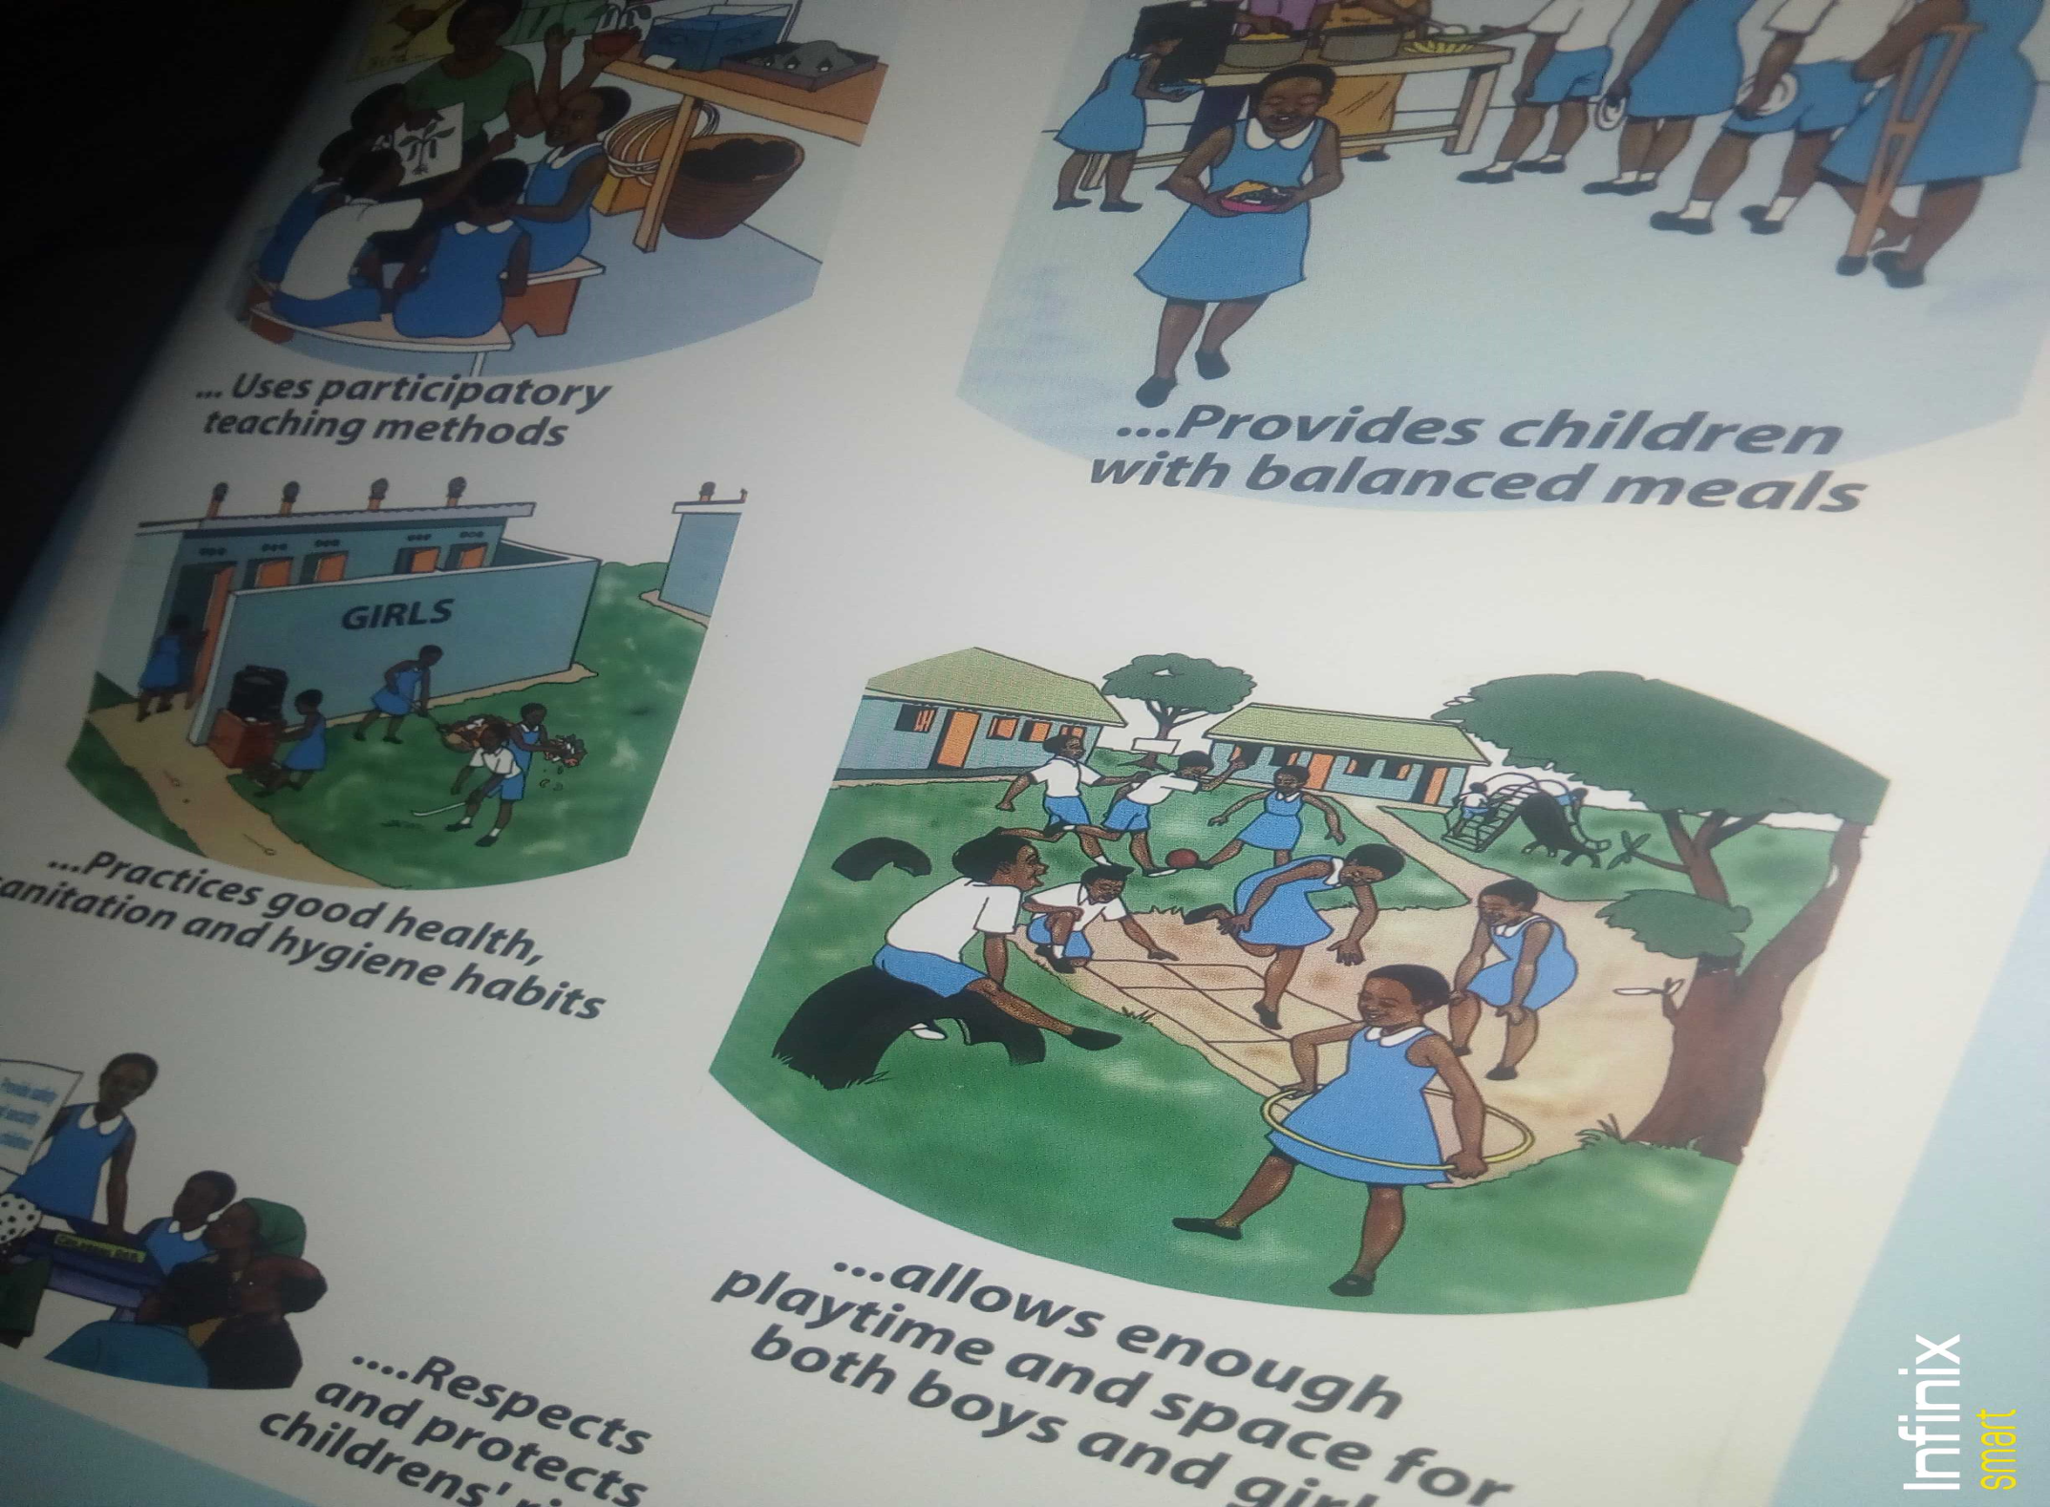

Slide 29
Free Writing
Safe learning environment & inhibiting factors
What are the positive things that enhance safe learning environment in your school ?
What are the negative things that constrain efforts toward creating a safe learning environment in your school

Slide 30

10 Traits of Successful School Leaders:
1. Understand the Importance of Building Community
Build and sustain reciprocal family and community partnerships.
Teachers are motivated and willing to try new strategies because they trust leaders to support them.

Slide 31
Traits Cont…
Students are motivated and connected to the school because they trust their teachers.
Families are supportive because school leaders and teachers have built trusting relationships with them.”

Slide 32

Traits Cont…
2. Empower Teachers and Cultivate
Leadership Skills
Great school leaders are not running a one-man show; they cannot do it alone.
They fully support teachers and staff by encouraging them to continually learn, develop and, to become leaders themselves.

Slide 33

Traits Cont…
3. Utilize Data and Resources
Leaders use data, to drive continuous improvement.
This is for promoting equitable and culturally responsive opportunities for all students.
Leaders are able to leverage data to make strategic decisions to benefit their students.

Slide 34

Traits Cont…
4. Have a Vision and a Plan
Leaders visionaries.
They unite a team around and a plan to help them get there.
They articulate their school vision and goals.
This provides momentum and direction for each and every team member.

Slide 35

Traits Cont…
5. Create Collaborative, Inclusive Learning
Environments
Inclusive learning provides students with access to flexible learning choices and effective paths for achieving educational goals in spaces where they experience a sense of belonging.
Educators prioritize inclusivity, create safe learning environments that nurture every student.

Slide 36

Traits Cont…
6. Are Passionate About Their Work
Passionate gives success and happiness in ones job.
Passionate people have contagious energy that can greatly affect teacher satisfaction and drive as well as student performance

Slide 37

Traits Cont…
7. Encourage Risk-Taking
Leaders encourage risk-taking amongst their subordinates and colleagues by creating a supportive environment that rewards successful ideas or initiatives and effort as well, no matter the outcome.

Slide 38

Traits Cont…
8. Lead by Example
Leading by example positions one as tremendous role model for students in their school or district and colleagues and parents as well.
One who leads by example receives respect and admiration, without which he or she will find little luck in leadership.

Slide 39

Traits Cont…
9. Persevere – staying in a school for at
least five years
Leaders who remain in their schools have improved schoolwide student achievement.
A Leader should be willing to commit to a school and persevere despite challenges.
10. Lifelong Learners
School leader should possess unquenchable thirst for knowledge

Slide 40

New Normal
Role of Head Teachers as Pedagogical Leaders in the context of new normal
Is a new way of living and going about our lives, work and interactions with other people.
It’s a current situation a social custom that is different from what has been experienced or done before but is expected to become usual or typical.
Leaders play a pivotal role in affecting the climate, attitude and reputation of their schools. They are the cornerstone on which learning communities function and grow (Berlin: Springer. Avery, Gayle, 2004).

Slide 41

Roles of Headteachers Cont…
Ensuring that there is a Plan and a and budget.
A supplementary budget may be made
and approved e.g. for COVID-19.
Management of school resources: e.g. human resource, financial resource, students and teacher activities,

Slide 42


Roles of Headteachers Cont…
Decision making:
Heads make decision in area of school Re- opening, in a closer collaboration with different stakeholders.
Coordinator. During lockdown and schools closure, there is needs to maintain continuity of learning and other activities of the school. E.g.
Organizes Regular meetings of the established Task forces to monitor the College environment during the COVID-19 pandemic period.
Provision of relevant information to all the stakeholders.

Slide 43
Roles of Headteachers Cont…
Councilor:
During this period of the COVID 19 crisis, the school heads play the role of a councilor, they become Centre for support and consolation to parents, student and community.
Provision of Personal Protective Equipment's (PPEs) in the for effective protection of the education Centre.
Preparation of posters and fliers with massages to guard against COVID-19

Slide 44
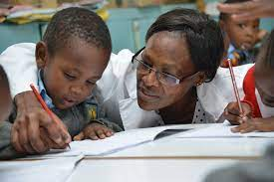
Roles of Headteachers Cont…
Briefs and trains security officers in SOPs ,to have Records of visitors and staff entering the College for reference.
Nurturing learning environment: Through involving involving all the stakeholders.
Establishment of new school cultures: in consideration of new normal in order to institute the new system in schools and sustain it.

Slide 45

Roles of Headteachers Cont…
Establishing COVID-19 isolation centres within the college
Getting regular reports on weekly and monthly basis from COVID-19 task force.
Liaison with district task force to share relevant information with them as appropriate on COVID-19 and Collaborates with different stakeholders.

Slide 46
Conclusion:
Educational leadership guarantees everyone’s support for their own development. The community builds opportunities to develop each individual. No matter what stages of life any of these individuals find themselves in, there is an awareness of the need to continually learn, stretch their skills, and engage with new information. Equity, equality, and social justice create another condition of educational leadership
School should be a place of resistance to injustice. Educational leadership is contextualized and reflective.

Slide 47
Conclusion Cont.d
Critical thinking about the context of the school and the state of the environment is an important starting point for building reflection.
Reflexivity is the ability to reflect on actions and strive to accurately assess reality, and to think about context in the cultural, material, and socio-political dimensions. Educational leadership is distributed and participatory (Bell, Les, and Howard Stevenson, 2006).

Slide 48
References
Aven, Terje, and Ortwin Renn. 2010. Risk Management and Governance. Concepts, Guidelines and Applications.
Bell, Les, and Howard Stevenson. 2006. Education Policy: Process, Themes, and Impact. London and New York: Routlege
Berlin: Springer. Avery, Gayle. 2004. Understanding Leadership: Paradigms and Cases. New York: SAGE Publications Ltd.
Dweck, Carol. 2006. Mindset: The New Psychology of Success. New York: Random House.
Fielding, Michael, and Peter Moss. 2011. Radical Education and the Common School. A Democratic Alternative. London and New York: Routledge
Knowles, M. S. (1980). The modern practice of adult education: From pedagogy to andragogy. Englewood Cliffs, NJ: Cambridge Adult Education.
Macneill, N., Cavanagh, R., & Silcox, S. (2005). Pedagogic Leadership: Refocusing on Learning and Teaching. InternationalElectronic Journal for Leadership in Learning.
Mythili, N. (2015). School Leadership Development: A Roadmap for Andhra Pradesh. Journal of Educational Planning and Administration, 29(4), 379-400.
Robinson, V., Hohepa, M. & Lloyd, C. (2009). School leadership and student outcomes:,identifying what works and why. Best Evidence Syntheses Iteration (BES). New Zealand: Ministry ofEducation.
Taylor & Francis Group. Biesta, Gert. 2015. What is Education For? On Good Education, Teacher Judgement, and Educational Professionalism. European Journal of Education
Wydawnictwo Dolno´sl ˛askie. Ciampa, Dan. 2016. When Charismatic Leadership Goes Too Far. Harvard Business Review, November 21.

Slide 49

Thank you

